Slide 1

Logistic Regression
Reading: 9.1-9.4
7.3-7.6
exercises: Ch 9. 21,33,35,37
Assigned: none
Producer: dr. mario
img credit: alex riegert-waters

Slide 2
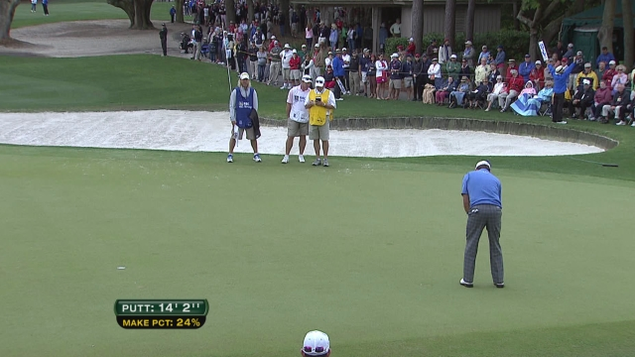
Motivation

Slide 3



Binary Logistic Regression Model
Response Variable is Binary (Coded as Indicator)
Predictor Variable Could Be Numeric or Categorical
Bad Idea -> Linear Regression or ANOVA
$$Y=\left\{\begin{aligned}1 if Yes \\ 0 if No\end{aligned}\right.$$
$$Y≠β_{0}+β_{1}X+ε$$
$$Y≠μ+α_{i}+ε$$

Slide 4

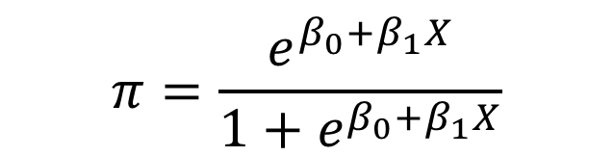
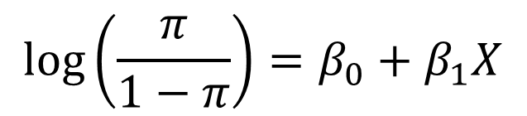

Binary Logistic Regression Model
Requirements
Logistic Regression Model
$$Y=Binary Response$$
$$X=Predictor Variable$$
$$π=P\left(Y=1 | X=x\right)=Proportion of 1^{′}s if X=x$$
$$\log\left(\frac{π}{1−π}\right)=β_{0}+β_{1}X$$
$$π=\frac{e^{β_{0}+β_{1}X}}{1+e^{β_{0}+β_{1}X}}$$
or
Linear Model

Slide 5


Binary Logistic Regression Model
Parameter $π$ Versus Statistic $p$
Example
$π$ = Probability of Having Green Eyes
Sample of 10 Random People
$p$ = Sample Average or Proportion of Blue-Eyed People in Sample
Another Reason Why Linear Regression or ANOVA Wouldn’t Work
$$0,1,1,0,1,0,0,0,0,0$$
$$p=\frac{0+1+1+0+1+0+0+0+0+0}{10}=\frac{3}{10}=0.3=30\%$$

Slide 6
Example: Grades on Different Exams
Data
Using One-Way ANOVA:
No Significant Differences Between Exams
Significant Differences Between Students
Question: Can we use both factors to explain variability in scores?
Barb Betsy Bill Bob Bud
Mean
72
87
68
73
75
62 94 68 86 50
87 95 93 97 63
74 86 82 70 28
77 89 73 79 47
Exam #1:
Exam #2:
Exam #3:
Exam #4:
Mean 75 91 79 83 47

Slide 7
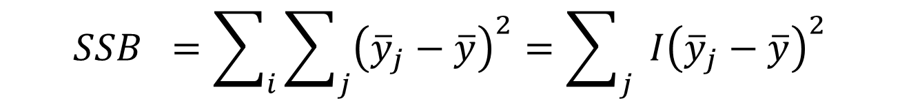
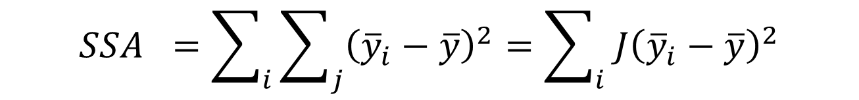

Two-Way ANOVA
Partition of Variation
$$SST =\sum_{i}{\sum_{j}{{\left(y_{ij}−\overline{y}\right)}^{2}}}=\left(n−1\right)s^{2}$$
$$SSA =\sum_{i}{\sum_{j}{{\left({\overline{y}}_{i}−\overline{y}\right)}^{2}}}=\sum_{i}{ J{\left({\overline{y}}_{i}−\overline{y}\right)}^{2}}$$
$$SSB =\sum_{i}{\sum_{j}{{\left({\overline{y}}_{j}−\overline{y}\right)}^{2}}}=\sum_{j}{ I{\left({\overline{y}}_{j}−\overline{y}\right)}^{2}}$$
$$SSE=SST−SSA−SSB$$

Slide 8
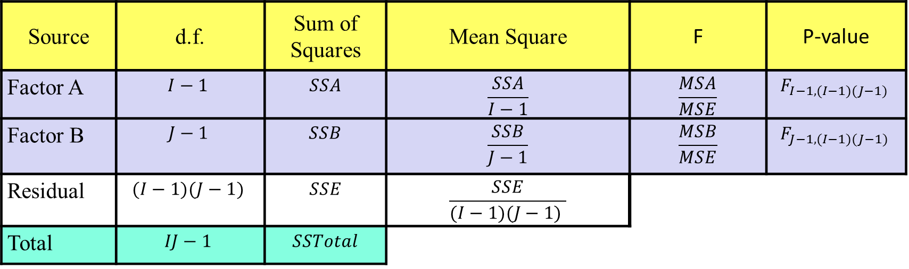
Two-Way ANOVA
ANOVA Table (Assume One Observation Per Combination)
Source | d.f. | Sum of Squares | Mean Square | F | P-value
Factor A | $$I−1$$ | $$SSA$$ | $$\frac{SSA}{I−1}$$ | $$\frac{MSA}{MSE}$$ | $$F_{I−1,(I−1)(J−1) }$$
Factor B | $$J−1$$ | $$SSB$$ | $$\frac{SSB}{J−1}$$ | $$\frac{MSB}{MSE}$$ | $$F_{J−1,(I−1)(J−1) }$$
Residual | $$(I−1)(J−1)$$ | $$SSE$$ | $$\frac{SSE}{(I−1)(J−1) }$$
Total | $$IJ−1$$ | $$SSTotal$$

Slide 9
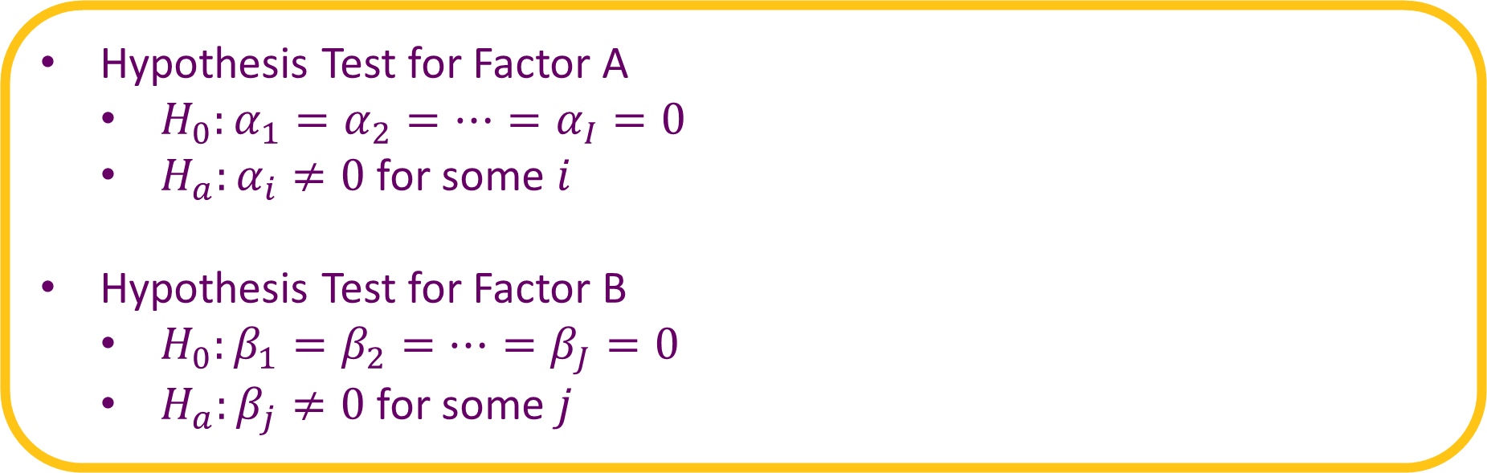
Two-Way ANOVA
Hypothesis Test for Factor A
$H_{0}:α_{1}=α_{2}=⋯=α_{I}=0$
$H_{a}:α_{i}≠0$ for some $i$
Hypothesis Test for Factor B
$H_{0}:β_{1}=β_{2}=⋯=β_{J}=0$
$H_{a}:β_{j}≠0$ for some $j$

Slide 10
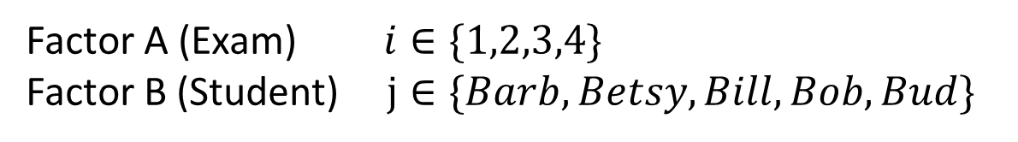
Supplement for Lecture 26
Fit One-Way ANOVA Models
Two-Way ANOVA Model
Compare to Results from One-Way ANOVA Models
Confidence Intervals for All Pairwise Comparisons (Tukey HSD)
$$Y=μ+α_{i}+β_{j}+ε$$
Factor A (Exam) $i∈\{1,2,3,4\}$
Factor B (Student) $j∈\{Barb,Betsy,Bill,Bob, Bud\}$

Slide 11

Interaction Effect
An Interaction Effect Occurs When a Significant Difference is Present at a Specific Combination of Factors
Example: Readability of Colored Text on Colored Background
Yellow Text Hurts Readability ($α_{y}<0$)
Black Background Hurts Readability ($β_{b}<0$)
Yellow Text on Black Background Helps Readability ($γ_{yb}>0$)
$$Y=μ+α_{i}+β_{j}+γ_{ij}+ε$$

Slide 12
Interaction Effect
Book: Interaction is a difference of differences.
Example:
 |  | White Background | Black Background | Diff
Yellow Text |  | 10 | 70 | -60
Gray Text |  | 40 | 50 | -10
Diff |  | -30 | 20
Different Differences
Different Differences

Slide 13

Interaction Effect
Estimation of Interaction Requires Multiple Observations Per Combo
Balanced: $n_{ij}=c$ (Constant for all cells)
Randomized Complete Block Design: $c=1$
Factorial Design: $c>1$
Use Interaction Plot to Inspect Presence of an Interaction Effect
Plot Means of Each Cell Versus One of the Factors With Different Lines for the Other Factor
Called Cell Means Plot
$$n_{ij}=\# of Observations in {\left(i,j\right)}^{th} cell$$

Slide 14
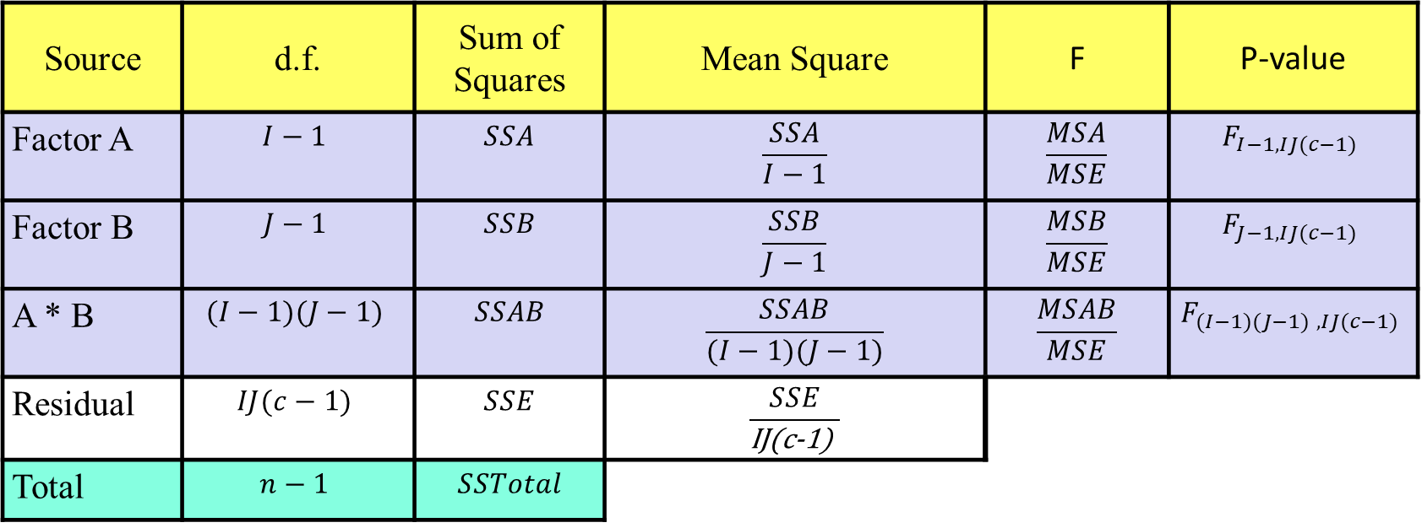
Interaction Effect
ANOVA Table
Source | d.f. | Sum of Squares | Mean Square | F | P-value
Factor A | $$I−1$$ | $$SSA$$ | $$\frac{SSA}{I−1}$$ | $$\frac{MSA}{MSE}$$ | $$F_{I−1,IJ(c−1) }$$
Factor B | $$J−1$$ | $$SSB$$ | $$\frac{SSB}{J−1}$$ | $$\frac{MSB}{MSE}$$ | $$F_{J−1,IJ(c−1) }$$
A * B | $$(I−1)(J−1)$$ | $$SSAB$$ | $$\frac{SSAB}{(I−1)(J−1)}$$ | $$\frac{MSAB}{MSE}$$ | $$F_{(I−1)(J−1) ,IJ(c−1) }$$
Residual | $$IJ(c−1)$$ | $$SSE$$ | $$\frac{SSE}{\text{IJ}\text{(}\text{c}\text{−1)} }$$
Total | $$n−1$$ | $$SSTotal$$

Slide 15
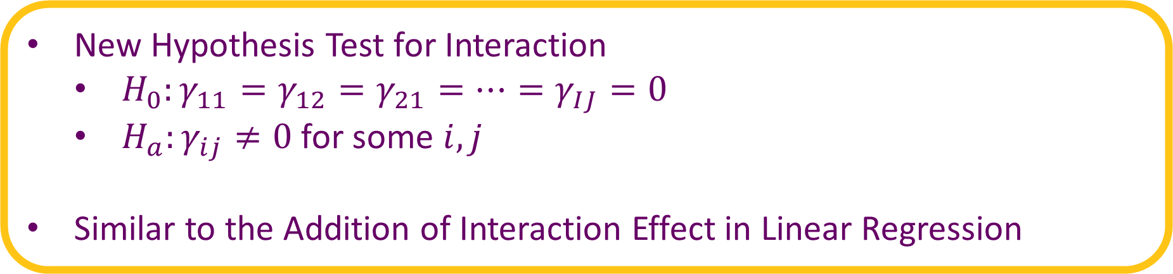
Interaction Effect
New Hypothesis Test for Interaction
$H_{0}:γ_{11}=γ_{12}=γ_{21}=⋯=γ_{IJ}=0$
$H_{a}:γ_{ij}≠0$ for some $i,j$
Similar to the Addition of Interaction Effect in Linear Regression

Slide 16

Example: Glue
Data Organized in Grid
A: Thickness (thin, moderate, heavy)
B: Glue Type (plastic, wood)
Y: Force Required to Separate (in Newtons)
DATA | Plastic | Wood
Thin | 52 64 | 72 60
Moderate | 67 55 | 78 68
Heavy | 86 72 | 43 51
$$I=3$$
$$J=2$$
$$c=2$$
$$n=I∗J∗c=12$$

Slide 17
Supplement for Lecture 26
Inspect Interaction Plot
Fit One-Way ANOVA Models
Fit Two-Way ANOVA Model Without Interaction
Fit Two-Way ANOVA Model With Interaction
Compare the Models and Inspect CI’s for Interaction Effects

Slide 18
Thank You
Make Reasonable Decisions

